Slide 1
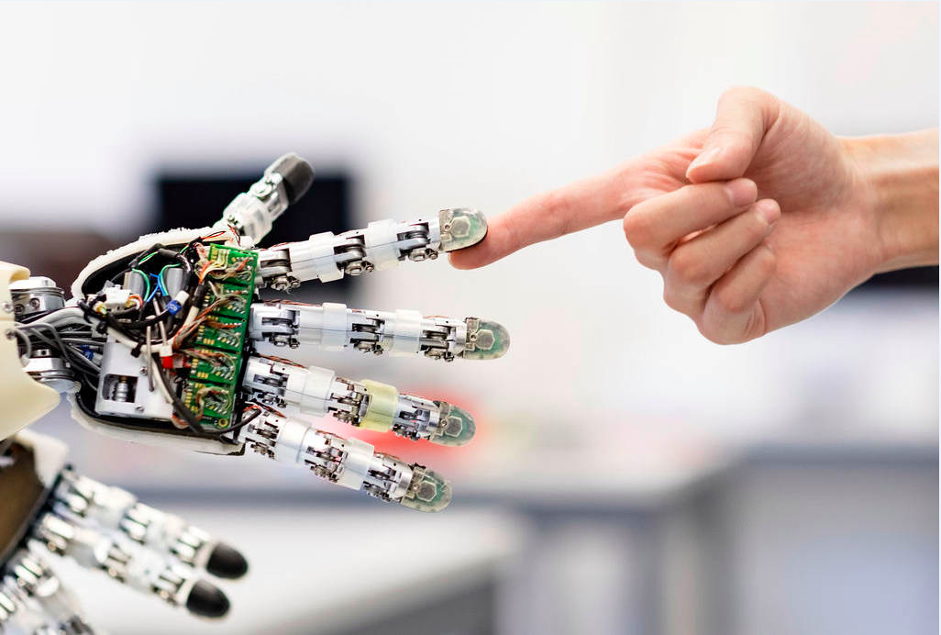


Ticket Enrichment using Machine Learning &
Automation Catalog Development
Prepared by,
B N S Vishal
160911122, IT-’A’, MIT, Manipal
Under the Guidance of
Mr. Govindarajan VS Head of Automation CoE TOC - Strategy and Transformation UBS India | Mrs. Anuradha Rao Asst. Professor Senior Scale Dept. of ICT M.I.T. Manipal

Slide 2
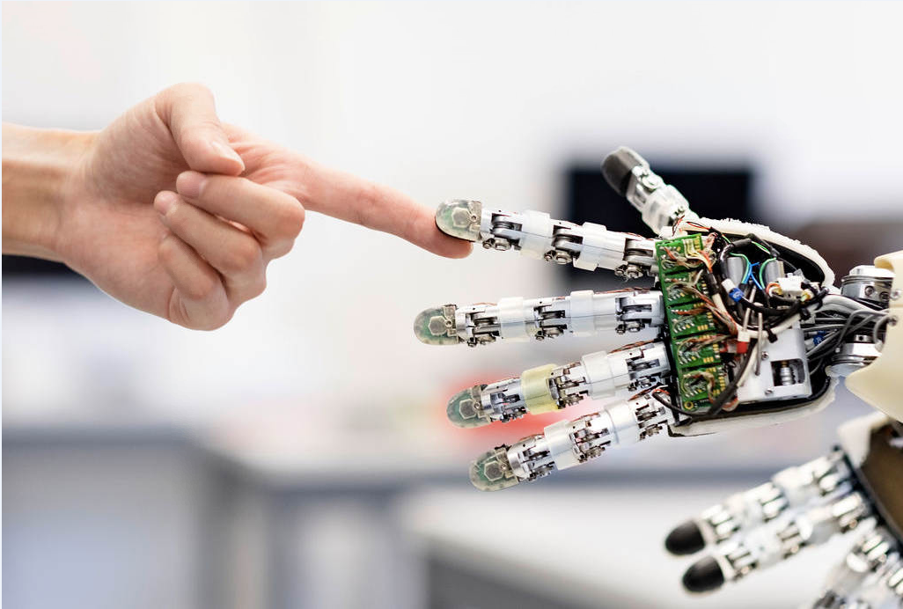
Introduction
Automation is the creation of software and systems to replace repeatable processes and reduce manual intervention. Regular health checks of remote servers, resolution of errors in applications and other all repeatable and mundane tasks could be automated.
The following two projects aim at delivering standardized and time & cost saving solutions to the automation developers and support analysts across the organization -
Ticket Enrichment using Machine Learning
Automation Catalog
.

Slide 3
The Automation Catalog
The Automation Catalog is a highly visible website across the organization.
It is conceived as a data store to record all live automations in TOC deployed through strategic platforms - IPCenter and Automation Anywhere and non-strategic platforms - Python, Shell, Perl etc. in order to promote ‘reusability’ of standardized and commoditized (off the shelf readily deployable) automations to save development time and to reduce risks and costs that may incur.
Tools and Development Environment-
The website is built using Angular 8.
IDE - IntelliJ Idea Ultimate 2019
Node Version - 10.16.9
NPM Version - 6.9.0
Angular CLI Version - 9.1.4
Bootstrap Version - 3.3.7

Slide 4
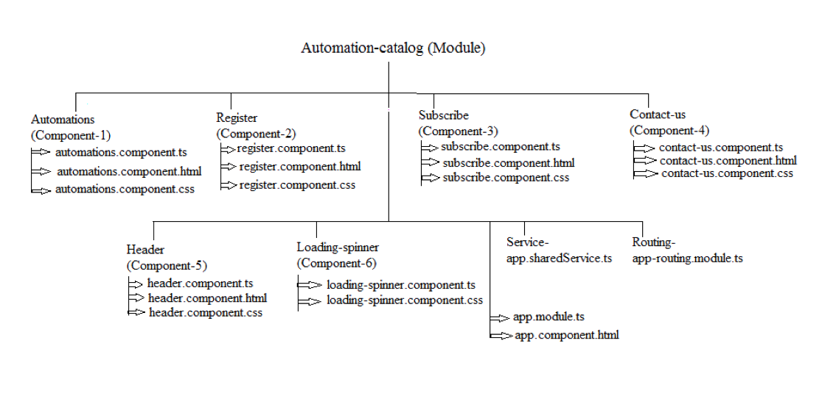
Application Structure/ Methodology

Slide 5
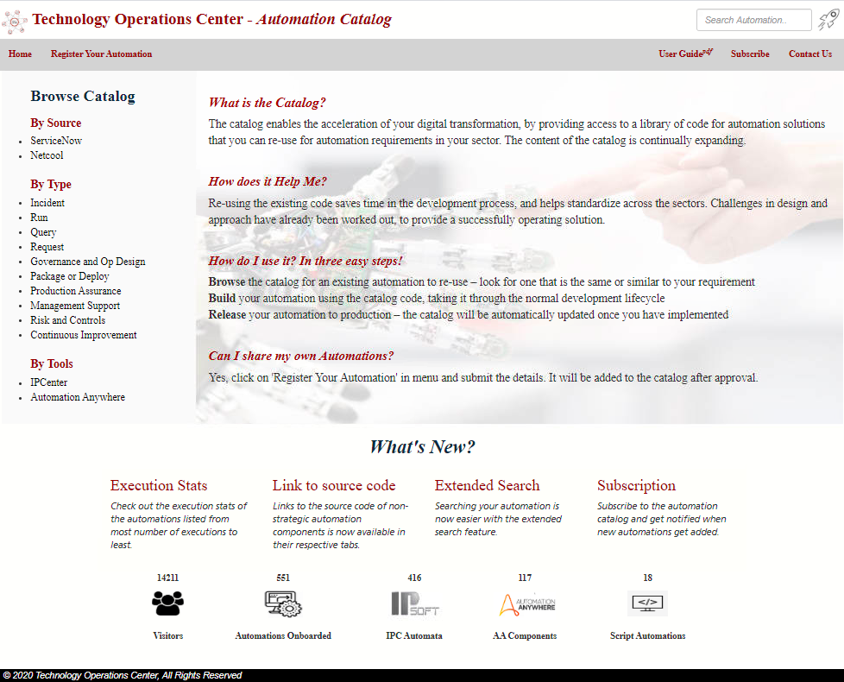

Slide 6
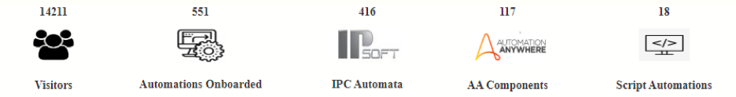
Automations Component
This component displays the homepage as well as the automation listings. Initially, the homepage is loaded whenever users visit the website.
The homepage is the main page that describes the ‘what, why and how’ of the catalog. It also displays some statistics about the site in the form of widgets on the bottom of the page.
Visitors count and the count of total automations onboard are done in the backend and the data is called using the HTTP GET method. The APIs are built using Python FLASK.

Slide 7
When user clicks on either of the links on the side panel, the ‘onSelect(domain)’ function is called and the domain is passed as parameter. This function hides all the content of the homepage except the side panel and displays the automation-list division. The data is called using HTTP GET method and the domain is passed as parameter. The API is built using Python FLASK.
The data is received in JSON format where each automation is an object and its description is listed in attribute-value format.
For each object (automation) a block is created that displays its name and description along with a ‘Read more’ button that when clicked, opens a pop-up on the screen with 5 tabs to display more information about the automation.
Following images show the automation listings for the ‘Incident’ type automations and the pop-up for the second automation in the Incident type automations listing and the data shown in each different tabs.

Slide 8
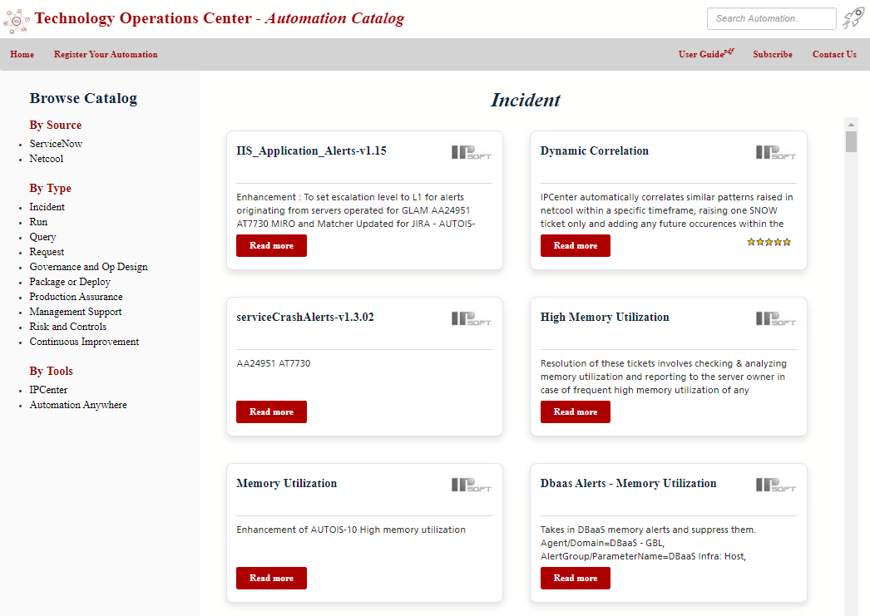

Slide 9
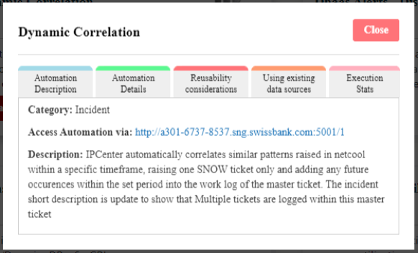
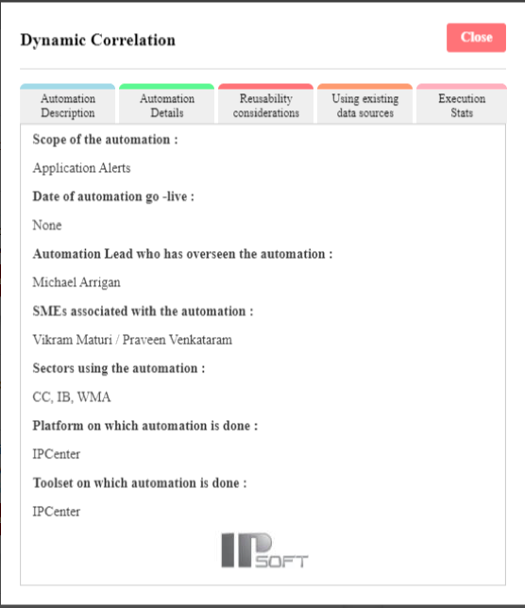
Automation Description Tab-
Automation Details Tab-

Slide 10
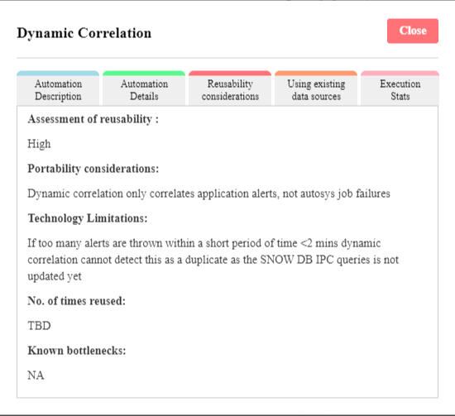
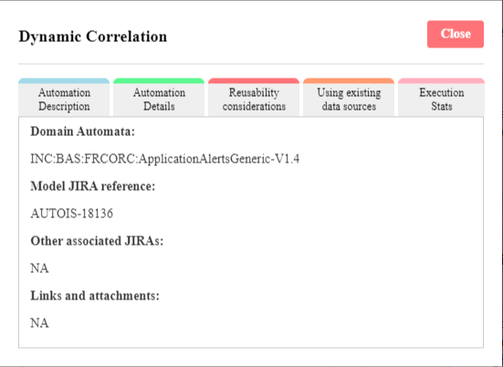
Reusability Considerations Tab-
Using existing data sources Tab-

Slide 11
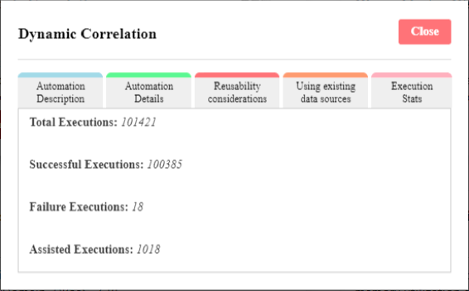
Execution Stats Tab-

Slide 12
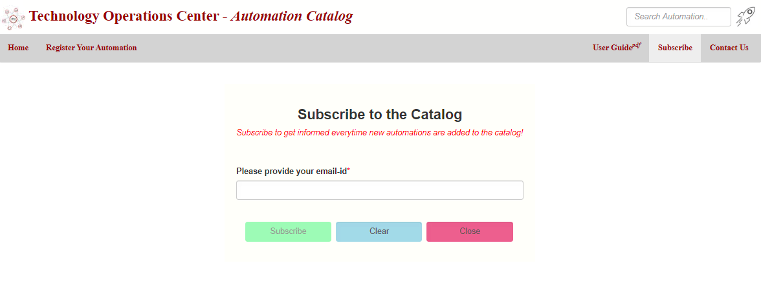
Subscription Page

Slide 13
Subscription Component - Pseudo Code
if (email does not end with ‘@ubs.com’) {
An alert message pops up requesting user to enter only UBS email.
}
else {
1. Retrieve all subscribed emails from the database server using HTTP GET method and
store the list in an array.
2. Do a linear search to check if the email entered by the user is present in the list or not.
if (email is present in the array) {
An alert message pops up with the message - ‘You have already subscribed to the
Catalog.’
} else {
1. Email entered is enclosed in the body of the request message of the HTTP POST
Method
2. Alert message pops up displaying the message - ‘Thank you for subscribing to the
Catalog!’.
}
}

Slide 14
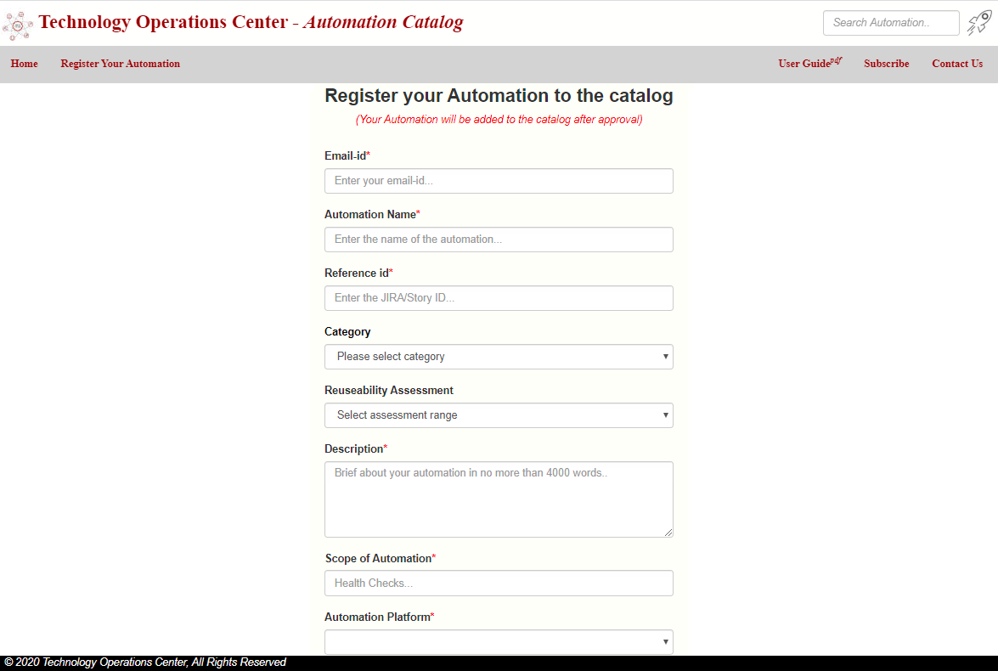
Automation Registration Page

Slide 15
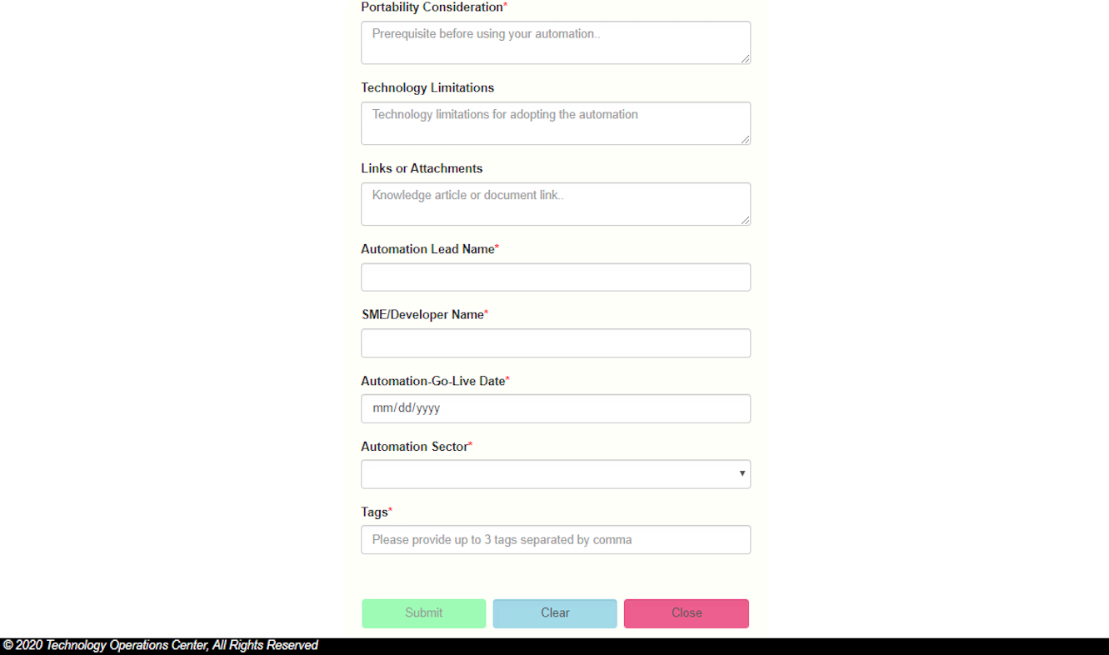
All required fields marked with asterisks must be filled for the ‘Submit’ button to be enabled.
The data is bound as a JSON object and passed as a parameter in the HTTP POST method and an alert message pops up that says - “Thank you for registering your Automation to the Catalog. The automation will be added after review by the central team.”
The details are then emailed to the central team for review.

Slide 16
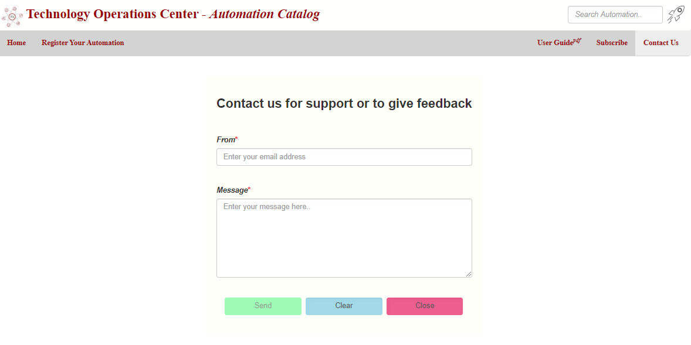
Contact Us Page
The ‘From email’ here too must be of ‘@ubs.com’ domain.
Data (‘From email’ and ‘Message’) is similarly bound as JSON object and passed as parameter in the HTTP POST method.
Central team receive the data and can resolve the queries by contacting the user.

Slide 17
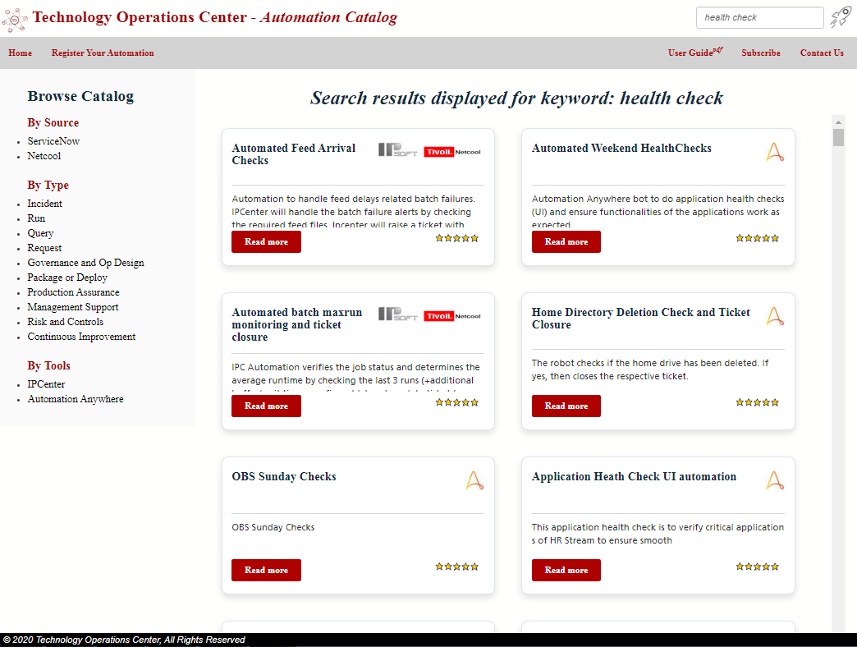
Search Function

Slide 18
Angular Service
The header component has an input field for searching automations.
Because the header and the main page are two different components, Angular Service is used for passing the search query from the header to the automations component.
Angular Subject is defined in the Service. It is a special type of Observable that allows data to be multicasted to many observers.
The form in the Header component is the observee and the Automations component is the observer.
Whenever a user enters a query, a ‘sendMessage(query)’ function is called and the subject is fed with a new value.
The Automation Component that is subscribed to observer of the subject - ‘getMessage() function’ written in the Service, ‘observers’ that the subject has received a new value, calls a ‘doSearch(query)’ function that retrieves the data from the server using the HTTP GET method and displays the results.

Slide 19
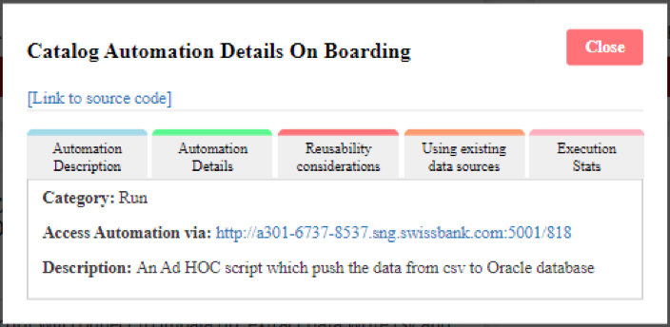
Links to Source code and Shareable links for Individual Automations
Automation scripts written in Python, Shell etc. are all pushed to a GitHub Repository and the ‘Link to source code’ placeholder below the automation name redirects the page to the GitHub repository on click.
Each automation has a unique ID in the catalog. Hence the links provided in the ‘Access Automation via’ field are unique and shareable between developers.

Slide 20
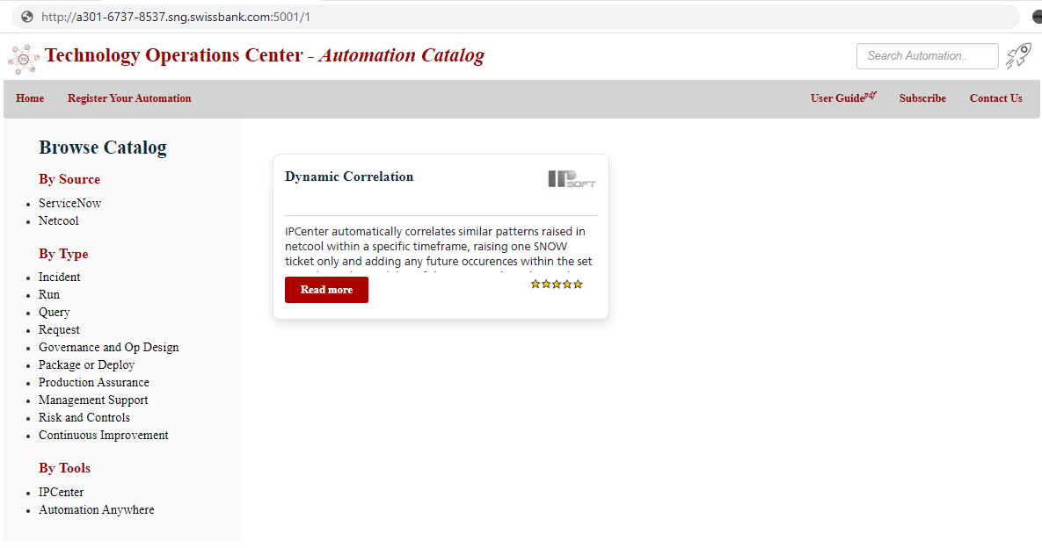
The following screenshot is of the page when user clicks on the link with Catalog ID = 1.

Slide 21
Routing Module
All the routes are configured in the ‘app-routing.module.ts’ file. Following are the routes-
1. path = ‘’, component = AutomationsComponent. This routes the application to the homepage.
URL= ‘http://goto/toc-automation-catalog/’.
2. path= ‘/register-automation’, component = RegisterComponent. This routes to the registration page.
URL=‘http://goto/toc-automation-component/register-automation’.
3. path= ‘/subscribe’, component = SubscribeComponent. This routes to the subscription page.
URL=’http://goto/toc-automation-catalog/subscribe’.
4. path= ‘/contact-us’, component = ContactusComponent. This routes to the contact-us page.
URL=’http://goto/toc-automation-catalog/contact-us’.
5. path= ‘:automationstype’, component = AutomationsComponent.
URL=’http://goto/toc-automation-catalog/:automationstype’.
‘:automationstype’ is a variable that is checked in the OnInit function of the Automations
component to load the automations page.
It is matched in the following way-

Slide 22
if(automationstype === ‘Incident’) {
onSelect(domainname) function is called and ‘Incident’ is passed as parameter.
} else if (automationstype === ‘Run’) {
onSelect(domainname) function is called and ‘Run’ is passed as parameter.}
.
.
Similarly other domains (Request, Query etc.) are called.
URLs= ‘http://goto/toc-automation-catalog/Incident’ or ‘http://goto/toc-automation-catalog/Run’….etc.
If ‘:automationstype’ is a number, this is mapped with the automation’s catalog ID and the ‘seatchbyid(id)’ function is called to display that automation. For example, the URL = ‘http://goto//toc-automation-catalog/1’ with display only the automation with ID=1 as shown in the image on slide 20.

Slide 23
Conclusion and Future Scope
The catalog has seen a really quick spike in visitor count since its release (3000 hits in 3 days) and a good number of users have subscribed to the catalog.
Future Scope -
Automate addition of new automations into the database.
Filter automations by execution stats, reusability considerations (high, medium and low).
Further enhancement of search by introducing search by name, description, tags or all.

Slide 24
Ticket Enrichment using Machine Learning
This solution is designed for the support analysts that work on resolving the errors generated by different applications by providing ‘labels’ for the latest errors.
The labels best describe the errors that guide the analysts to know what steps to follow for their resolutions.
Objectives-
To develop an automation in IPCenter that extracts the latest errors for particular jobs of an application by logging into the server and enriches the IT ticket data with the error labels predicted using Machine Learning.
To help incorporate the automation component with the wrapper automations developed by the automation developers of Asset Management and Investment Banking teams.

Slide 25
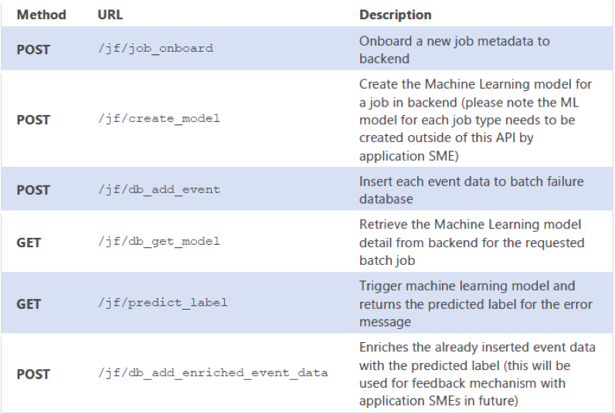
APIs used -
The following screenshots are of the IPCenter Automation Component

Slide 26
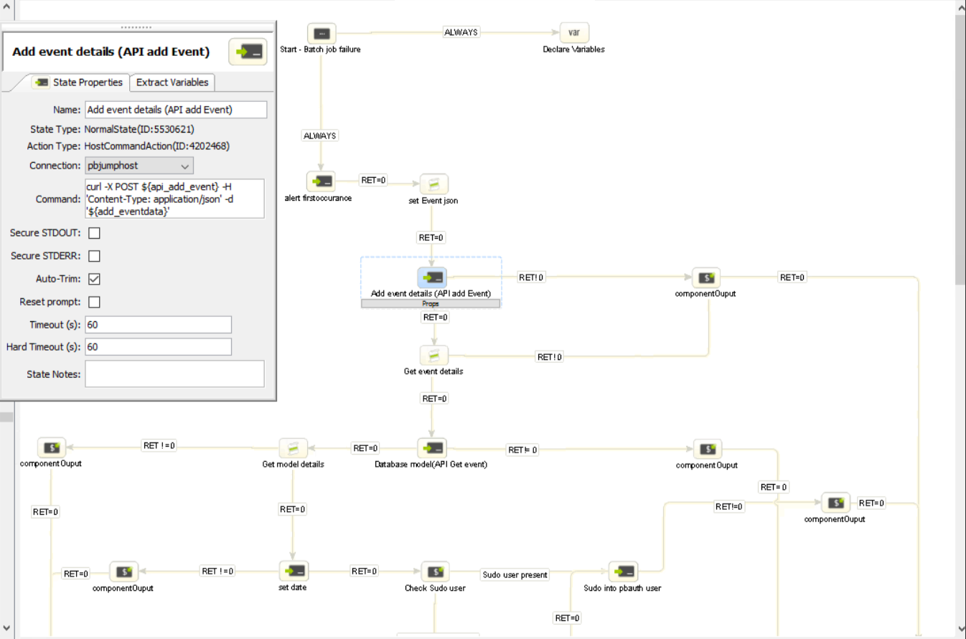

Slide 27
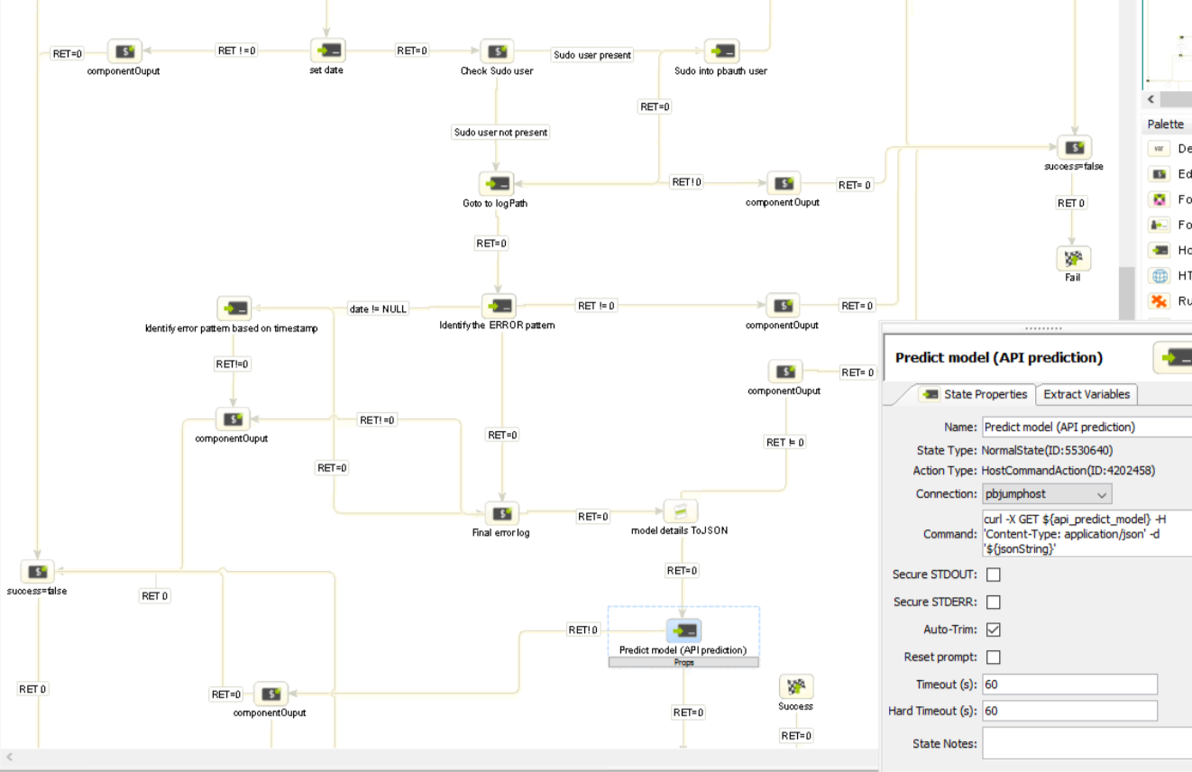

Slide 28
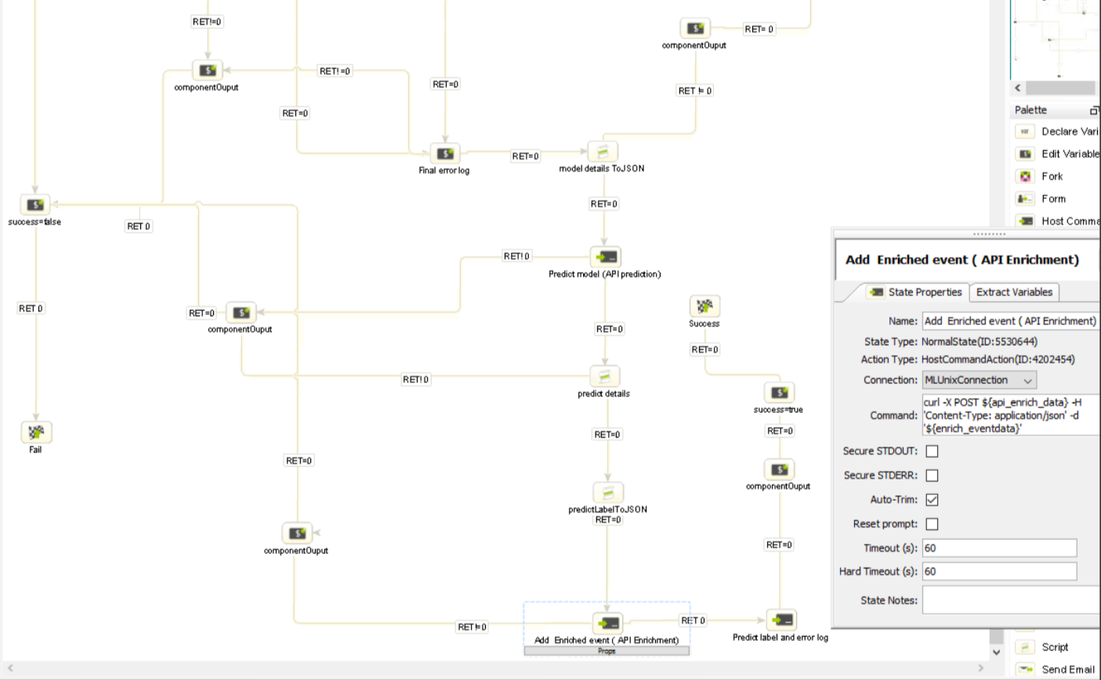

Slide 29
Incorporating the IPCenter Automation Component
The two teams - Asset Management and Investment Banking were assisted with incorporating the ML component into their respective IPC automation wrappers. Following are the steps followed for both the teams-
Job names and error log data (~90 days) of applications were collected from the teams.
Preprocessing of the errors data (removing headers and footers and manual labeling of the errors) was performed.
MLP algorithm was run on those error data.
The model was pickled and stored by calling the create_model API.
The ML automation component was added as a link in the automation wrappers developed by the respective teams.

Slide 30
Conclusion and Future Scope
The ML automation component linked to the automation wrappers, enriched the tickets with the error labels.
The future scope is to automate some of the resolutions of the errors based on the error label predicted.
For example, most of the errors require a restart of the application. Hence, whenever such errors get predicted with the error label, the error label can be mapped with the process it must follow for resolution. Here, the process is restart of the application.

Slide 31
Thank you!

